Slide 1
What are the ways to map logic values and mechanical values to voltage levels?

Slide 2
Meaning of Active high and Active low
Electronic circuits operate on voltages rather than logic levels
Every truth table has two interpretations in voltage levels
General concept:
Assume logic 1 is represented by a higher voltage than logic 0: called Active High or Positive Logic
To assert a signal, place a positive voltage on the wire and it is treated as a logic 1

Slide 3
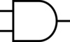
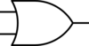
active High and active Low
Alternatively:
A low voltage can be used to denote that a signal is asserted and high voltage when unasserted
Truth table comparison
Voltage truth table Positive Logic Negative Logic
F
A | B | F |  | A | B | F |  | A | B | F
Low | Low | Low |  | 0 | 0 | 0 |  | 1 | 1 | 1
Low | High | Low |  | 0 | 1 | 0 |  | 1 | 0 | 1
High | Low | Low |  | 1 | 0 | 0 |  | 0 | 1 | 1
High | High | High |  | 1 | 1 | 1 |  | 0 | 0 | 0

Slide 4
Meaning of “active” for inputs
For external inputs to a logic circuit we can adopt a view of active high/low with respect to the user’s assertion action
Typically, push the button is assertion and “active”
What voltage level is generated by asserting the button?
If low voltage w/ push, then user input is Active Low
If high voltage with push, then Active High

Slide 5
AcTiVe HiGh and AcTiVe LoW – I’m confused
Very real possibility of confusion
Avoid mixing positive and negative logic in a design when possible (Not always possible)
Can adopt the convention that gates are positive logic then
Place a “bubble” on an input or output that is to be asserted low
Label a signal as X’ if it is asserted with a low voltage

Slide 6
aCtIvE hIgH AND aCtIvE lOw
At the root of it all is duality in Boolean logic
=

Slide 7
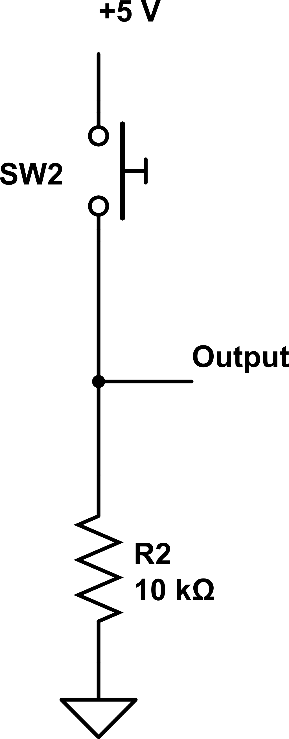
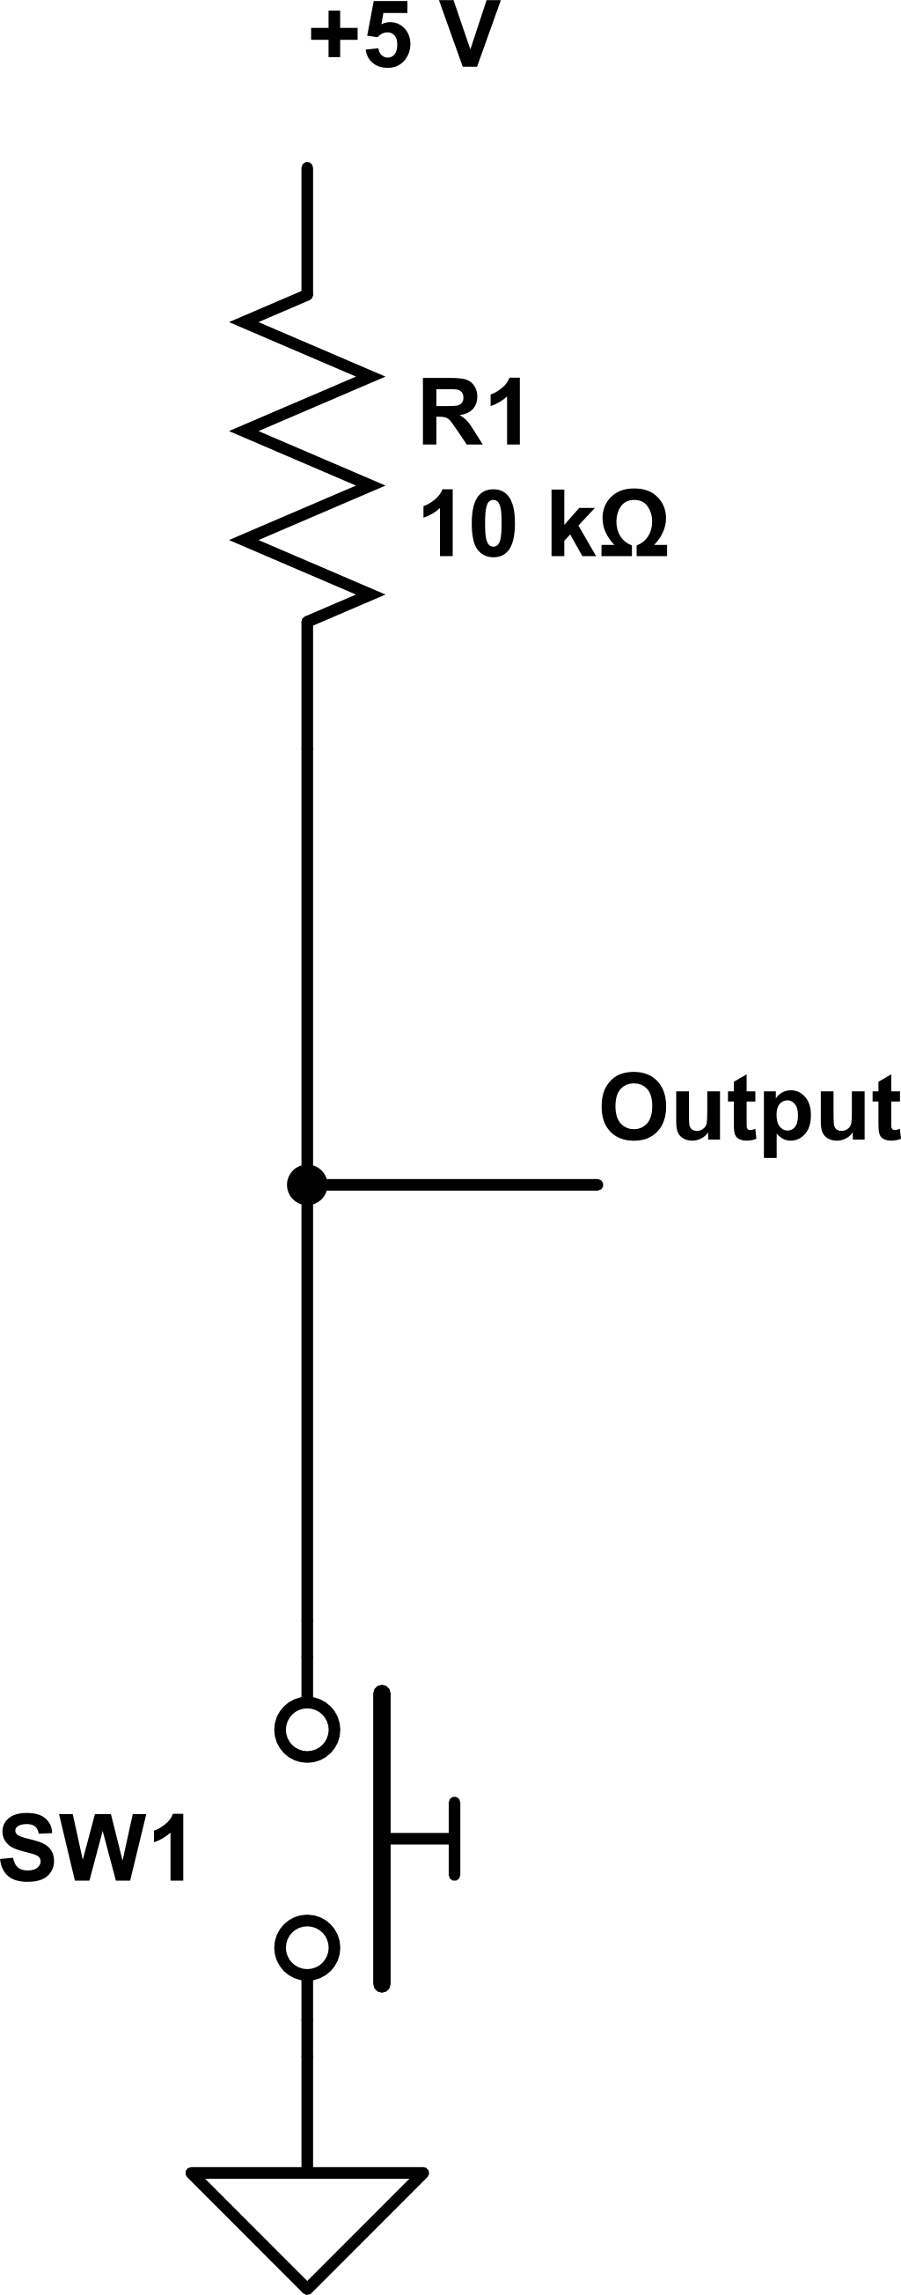
Active high & low mechanical switch input examples: push = assert input
Active high input: Active low input: Output = +5 V if push Output = 0 V if push

Slide 8
Lab 02 Announcements
Will announce Wednesday the policy for Lab 02 “Did not finish In-Lab work” situation
Demo Lab 02 Take-Home circuit this week; do not show In-Lab circuit
Upload answers to lab questions

Slide 9
Announcements
HW03 due Thursday
Read chapter 4 this week
Lab 03 – The Decoder: Issues this week, due next week

Slide 10
How does abstraction help with thinking about computers?

Slide 11
Lecture 06 – Computer building blocks
2018.01.22
It has long been an axiom of mine that the little things are infinitely the most important.
– Arthur Conan Doyle

Slide 12

Components of a computer
Useful decomposition of computer into 5 subsystems: input and output (I/O), memory, and data path and control (processor)
Key design criteria focus on the User, delight, translation, performance, as well as the 5 subsystems
Performance
Evaluation – Time and Costs
Program Translation
Processor
Memory
Instructions
Input
User
Control
←Operands
Results →
Output
Delight
ALU

Slide 13
Nice diagram, but Organizational level abstraction
Performance
Evaluation – Time and Costs
Program Translation
Processor
Memory
Instructions
Input
User
Control
←Operands
Results →
Output
Delight
ALU

Slide 14
Where is the Implementation level?
Performance
Evaluation – Time and Costs
Program Translation
Processor
Memory
Instructions
Input
User
Control
←Operands
Results →
Output
Delight
ALU

Slide 15


Implementation is less abstract than Organization
Quack
Performance
Evaluation – Time and Costs
Program Translation
Processor
Memory
Instructions
Input
User
Control
←Operands
Results →
Output
Delight
ALU
CS250 is about what happens down here to make up there USEFUL

Slide 16
What does software require?
Input/Output
Functions
Data
Control structure
Automatic execution
Model of Execution

Slide 17
What does software require? Why?
Input/Output
Functions
Data
Control structure
Automatic execution
Model of Execution
Usefulness
Basic computation
Operands
Computation at a higher level of abstraction
Technology-improved computational time and cost
Axiom(s) of automatic execution

Slide 18
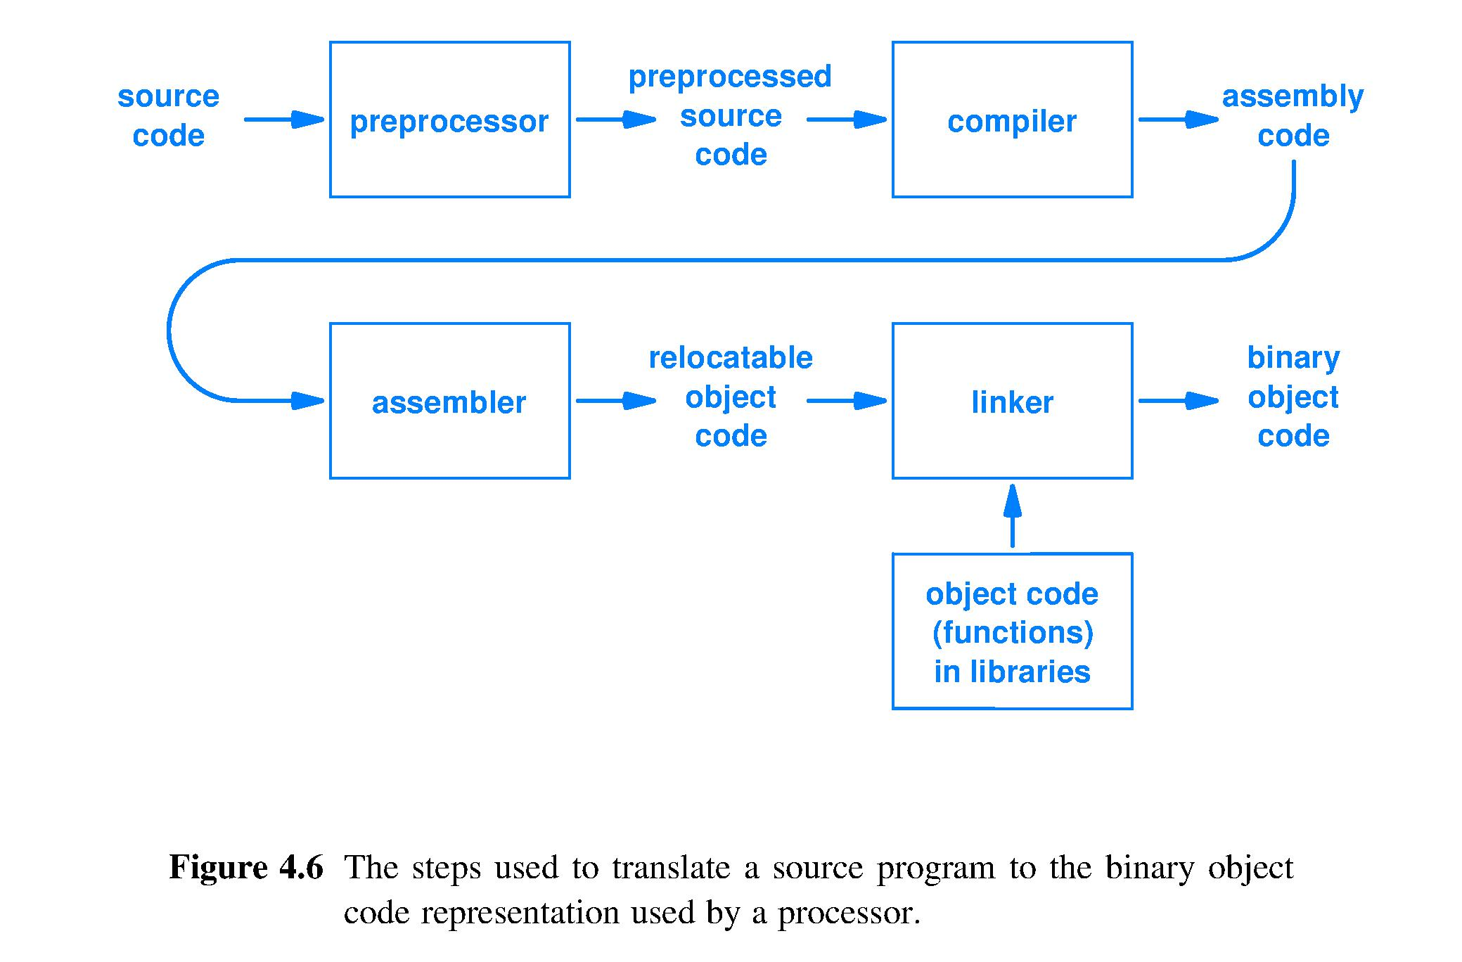
Before software can run, prepare
Load this in memory, as prescribed by the Model of Execution, then can run

Slide 19
Fetch-Execute Cycle: a model of execution
[Text page 78] Most processors are designed to start executing this algorithm immediately upon receiving power:
Repeat forever* {
FETCH ; // access the next step of the program
from the location in which the program has been stored
EXECUTE ; // perform the step of the program
}
*Provided the hardware receives power and has not been instructed to halt
Notes:
Simple, single purpose computers often do not have a HALT instruction: Apple TV, a microwave oven controller, …
For these computer systems, to stop execution we must remove the power source.

Slide 20
How can hardware (HW) fetch?
Fetch = access the next step of the program from the location in which the program has been stored
Access requires
Identifying where the next step is stored
Transporting a copy of the next step to where it will control the action of the processor
Next step is
A representation, using high and low voltages, of an action for the processor to perform

Slide 21
A circuit to identify where: the decoder
Identifying where is called naming, addressing, or pointing
The act of pointing informs a location that it has been selected
Therefore, hardware points by asserting a voltage on a wire that connects the pointing circuit to the selected location
n-to-2^{n} line decoder, or just n-to-2^{n} decoder: a circuit that takes an n-bit address as input and asserts a voltage on the 1 of the 2^{n} output wires that corresponds to the n-bit address

Slide 22
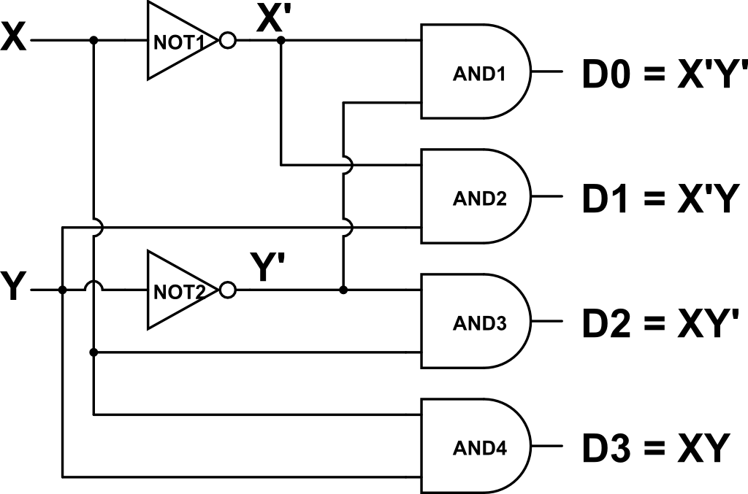
Example: active-high 2-to-4 decoder
Input is a 2-bit unsigned integer with bits XY, Output points to 2²=4 locations: D0, D1, D2, D3
Truth table and circuit; 2 inputs, 2² outputs, asserted output identified by logic 1 voltage
X | Y | D0 | D1 | D2 | D3
0 | 0 | 1 | 0 | 0 | 0
0 | 1 | 0 | 1 | 0 | 0
1 | 0 | 0 | 0 | 1 | 0
1 | 1 | 0 | 0 | 0 | 1

Slide 23
Active-high 3x8 Decoder
A2 | A1 | A0 | Y7 | Y6 | Y5 | Y4 | Y3 | Y2 | Y1 | Y0
0 | 0 | 0 | 0 | 0 | 0 | 0 | 0 | 0 | 0 | 1
0 | 0 | 1 | 0 | 0 | 0 | 0 | 0 | 0 | 1 | 0
0 | 1 | 0 | 0 | 0 | 0 | 0 | 0 | 1 | 0 | 0
0 | 1 | 1 | 0 | 0 | 0 | 0 | 1 | 0 | 0 | 0
1 | 0 | 0 | 0 | 0 | 0 | 1 | 0 | 0 | 0 | 0
1 | 0 | 1 | 0 | 0 | 1 | 0 | 0 | 0 | 0 | 0
1 | 1 | 0 | 0 | 1 | 0 | 0 | 0 | 0 | 0 | 0
1 | 1 | 1 | 1 | 0 | 0 | 0 | 0 | 0 | 0 | 0
Three address bits A₂A₁A₀ name 2³ = 8 locations (8 rows)
Eight outputs, Y₇Y₆ … Y₁Y₀, each point to 1 distinct location
Notes:
Easy SOP circuit

Slide 24
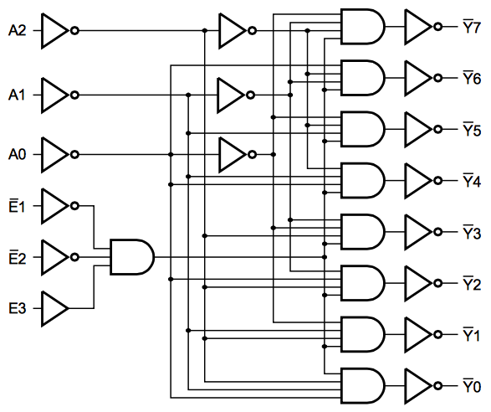
Lab kit 74138 chip, active-low 3-to-8 decoder
74138 has E1, E2, and E3 inputs to link
8 SOP terms
The following is not part of 3-to-8 decoder function; just useful additional functionality
Address bits
Inverters boost power to drive wide range of devices; make decoder active-low
Signals used if wish to link two or four 74138 chips into a 4-to-16 or a 5-to-32 decoder, respectively

Slide 25
Multiplexer/demultiplexer both point & transport
Bus – collection of N wires used to carry N bits of data simultaneously from place to place
Circuit to select & transport between 1 and 2^{k} data buses
Multiplexer (Mux): select 1 of 2^{k} input buses and forward selected input to the 1 output bus
Demultiplexer (Demux): forward the 1 input bus to the selected 1 of 2^{k} output buses
Mux used to read (copy) bits from the pointed to location
Demux used to write bits to the pointed to location [written bits replace prior bits]

Slide 26
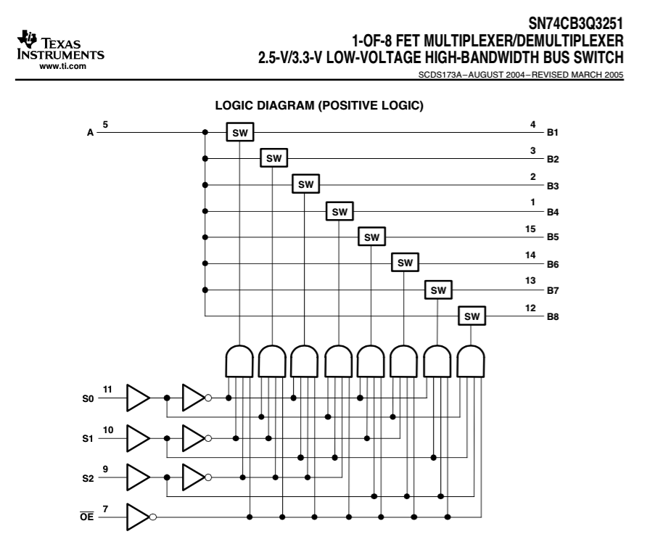
74251 chip: 1-of-8 mux/demux circuit
A is Demux input, or Mux output
B1 to B8 are Demux outputs, or Mux inputs
Data paths in blue
8 SOP terms
3 pairs of input drivers
Control path
Enable’

Slide 27
1 of 2^{n} multiplexer, more abstractly
Input lines; selected from; one is sent to output
0
1
…
2^{n-1}
Selection Pointer Address
0
1
Mux
…
n
No circuit now; just a box labeled Mux
Output

Slide 28
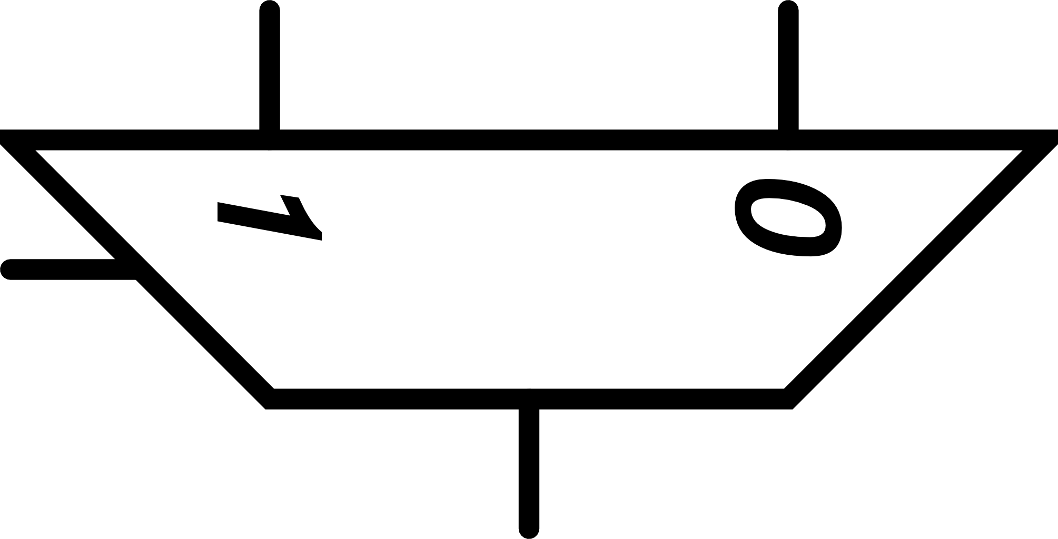
Multiplexer yet more abstractly
Even more abstract mux symbol used in our textbook
Address lines omitted; only 2^{n} input lines and the one output line shown

Slide 29
Fetch-Execute example
To automate this software, what is fetched?
int main( void )
{
printf(“hello, world\n”);
}

Slide 30
Fetch-Execute example
To automate this software, what is fetched?
• Fetch the printf “step” code
int main( void )
{
printf(“hello, world\n”);
}

Slide 31
Fetch-Execute example
To automate this software, what is fetched?
• Fetch the printf “step” code
• Fetch the printf operands
int main( void )
{
printf(“hello, world\n”);
}

Slide 32
Fetch-Execute example
To automate this software, what is fetched?
• Fetch the printf “step” code
• Fetch the printf operands
• Notation to set automation environment
• Notation to assist compiler in parsing
int main( void )
{
printf(“hello, world\n”);
}

Slide 33
Summary
Decoder is a circuit that points
n-bit address is input, causing
1 of 2^{n} output wires to deliver the asserted voltage level to the selected location
Multiplexer is a circuit that both points and transports bits from a selected/addressed location to a common location
Fetching is what a processor does the most
Fetching a sequence of program instructions can be accomplished with
a multiplexer and
a sequence of addresses that corresponds to the program execution sequence

Slide 34
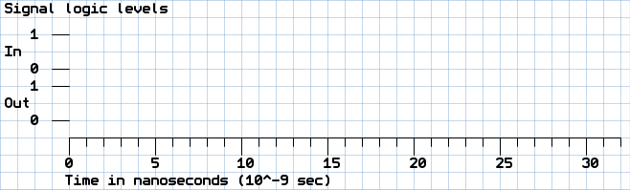
Announcements
If the least significant digit of your PU ID is even, then pick up a Signal Logic Level graph from the desk in the front of the room

Slide 35
How can
we make
a circuit with
“total recall”?

Slide 36
Lecture 07 – Adding
2018.01.24
“And you do Addition?” the White Queen asked. “What's one and one and one and one and one and one and one and one and one and one?”
“I don't know,” said Alice. “I lost count.”
“She can't do Addition,” the Red Queen interrupted.
from Through the Looking-Glass by Lewis Carroll
Notes:
Bring to class: Pentium chip, 7400 data sheet, ABE 5-pole, 25-throw switch

Slide 37
A hardware circuit we really need
What operation is performed most frequently by computer hardware?
Pointing?
Function call and return?
Memory allocation?
Adding two integers?
All of the above can use or need to perform unsigned integer addition
Design a circuit to add two unsigned integers

Slide 38
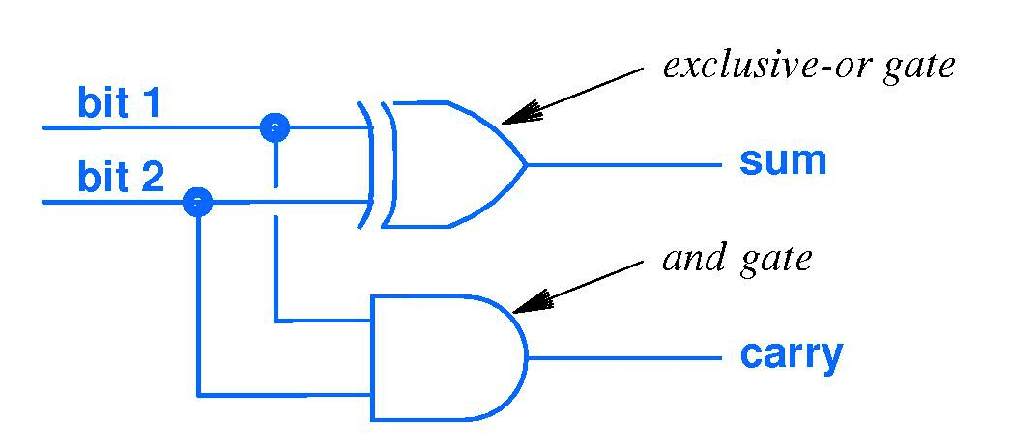
Binary addition and the Half Adder
To start circuit design, try adding just 2 bits (no carry in)
Carry in | Addend | Augend | Sum | Carry out
0 | 0 | 0 | 0 | 0
0 | 0 | 1 | 1 | 0
0 | 1 | 0 | 1 | 0
0 | 1 | 1 | 0 | 1
1 | 0 | 0 | 1 | 0
1 | 0 | 1 | 0 | 1
1 | 1 | 0 | 0 | 1
1 | 1 | 1 | 1 | 1
Addend
Augend

Slide 39
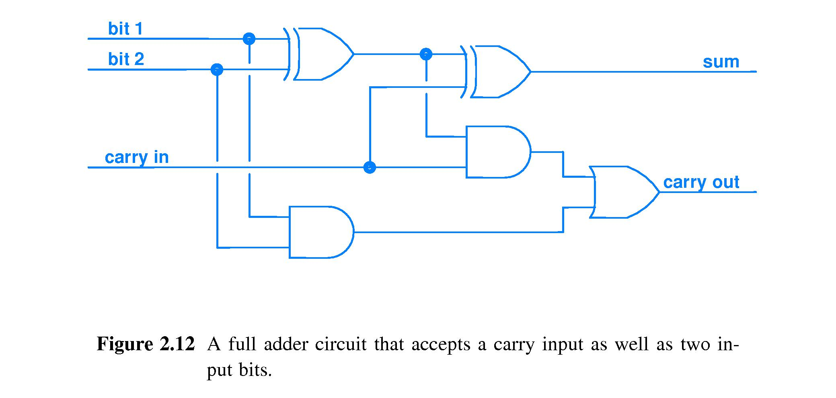
Binary addition – Full Adder
Adds carry in
Addend
Half adder
Half adder
Sum
Augend
(sum of 3 bits)
Carry
(carry out from 3 bits)
Carry
If XOR gate built using 8 CMOS transistors, then full adder has 28 transistors.
Notes:
Addition we do all the time. Speed of this operation is very important. How many gate delays for this circuit?

Slide 40
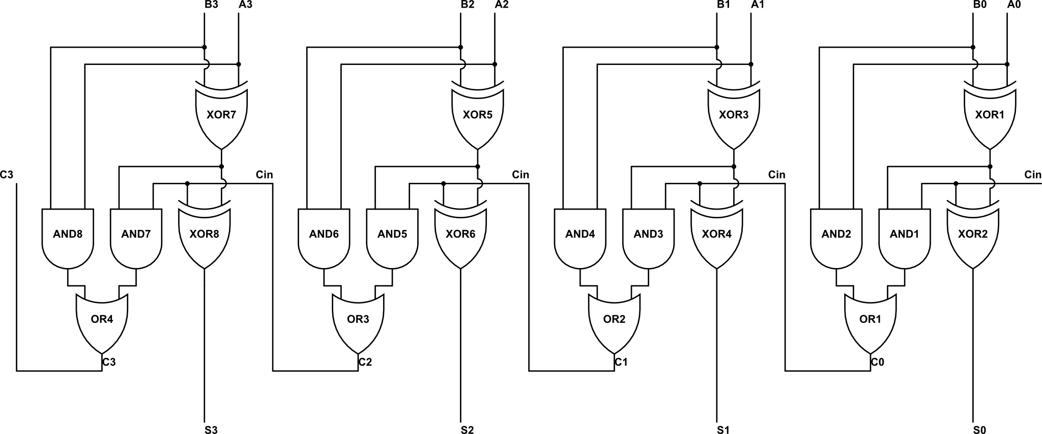
4-bit adder constructed via replication
Input 4-bit addend A₃A₂A₁A₀ and augend B₃B₂B₁B₀ here
C₃ carry output here
C₀ carry in input here
MSB
4-bit sum S₃S₂S₁S₀ output here
LSB
Circuit propagation delay (units of gate delays) =
0 1 2 3 4 5 6 7 8 9
Circuit has 4 x 28 = 112 transistors
Notes:
Replication is the HW Engineer’s friend, just like Iteration is the SW developer’s friend.

Slide 41

64-bit ripple-carry adder
Replicate 4-bit ripple carry adder 16 times
Circuit uses 1792 transistors

Slide 42
Week 03 assignments
HW 02 due Thursday, Jan 25
Read chapter 4 for this week; read chapter 3 for next week
Lab 03 is issuing this week, due next week
Notes:
15 clickers recorded, but without associated student name

Slide 43
Announcements
If you wish a DRC environment for midterm
Provide me your Letter of Accommodation by Wednesday, Jan. 31
Request DRC evening time for Feb. 06

Slide 44
Lecture 07 (déjà vu) – Remembering
It’s 2018.01.24 all over again.
We Can Remember It for You Wholesale
by Philip K. Dick
Appeared in the April 1966 edition of
The Magazine of Fantasy and Science Fiction.
Short story that inspired the movie Total Recall
Notes:
Bring to class: Pentium chip, 7400 data sheet, ABE 5-pole, 25-throw switch

Slide 45
What capability to implement next?
Circuit that can ADD points the way to other circuits for other functions, e.g., subtract, compare, et cetera to execute
Goal: Hardware that can store and then execute programs autonomously
Must have hardware memory to store programs and allow instructions to be read (copied) to the processor with its circuits for various computational functions

Slide 46
Gate specifications (specs)
To ensure gate operation in a wide variety of environments, extensive engineering and measurement performed
Gate speed is always of interest
Propagation delay – elapsed time from a gate input change until a gate output change
May not be symmetric: Low to high transition T_{PLH} may take longer than H to L, T_{PHL}, or vice versa
Input changes that do not cause an output change do not define T_{PLH} or T_{PHL}

Slide 47
Look SN74HCT00N Data Sheet
Here is the data sheet from manufacturer Texas Instruments for the NAND chips in your lab kit

Slide 48
Going beyond combinatorial circuits
Combinatorial logic – implements functions of logic inputs to generate a result or output (defined by a truth table)
Nice, but a logic circuit will be more powerful if its output can also be a function of time
What does it mean for a function to include time as an input? For a circuit?
Function and circuit behavior will depend on HISTORY, as experienced by circuit

Slide 49
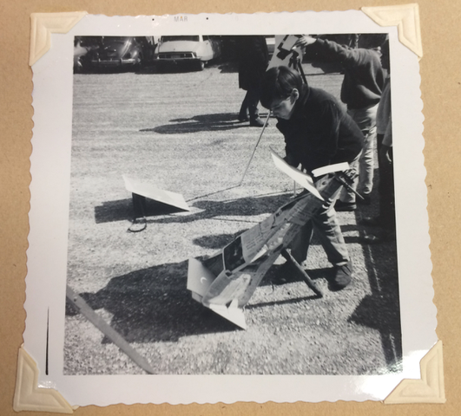
“One time a guy handed me a picture, he said
‘Here’s a picture of me, when I was younger.’
Every picture of you is when you were younger! 🤨”
– Mitch Hedberg, paraprosdokian comedian
This photo is a memory.
Memory lets us time travel.
How can we build a circuit with memory?
Me, watching the total solar eclipse
of March 07, 1970

Slide 50
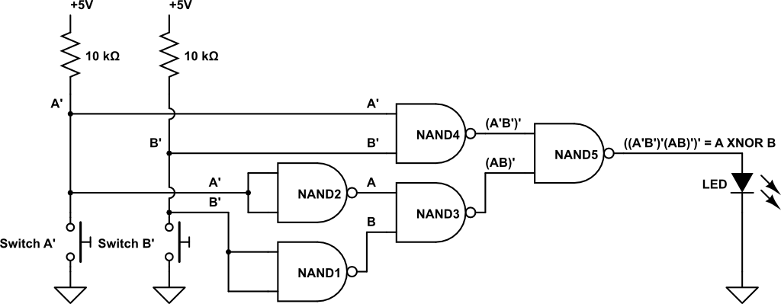
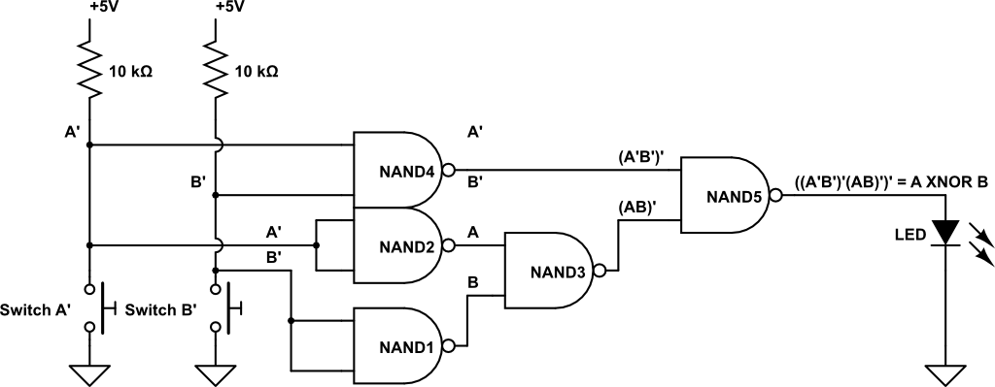
History as location in a logic circuit
Where is history in a logic circuit?
Here is computed response to the
inputs of
10ns ago →
Here is computed response to the
inputs of
20ns ago →
Here is computed response to the
inputs of
30ns ago →
Here is computed response to the
inputs of
35ns ago →
Inputs occur now Time = 0 ns ago→
Notes:
First cut at timing depicting needs a tweak. Circuit tweaked by moving NAND4.

Slide 51
Digital logic signal voltage waveform
Names for the parts of a logic signal
Time advances →
10⁻⁹seconds per tic mark, for example
High band
Low band
1) Low level
1) Low level 2) High level
1) Low level 2) High level
3) Rising edge 4) Falling edge
1) Low level 2) High level
3) Rising edge
1) Low level 2) High level
3) Rising edge 4) Falling edge

Slide 52
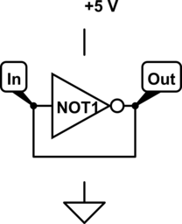
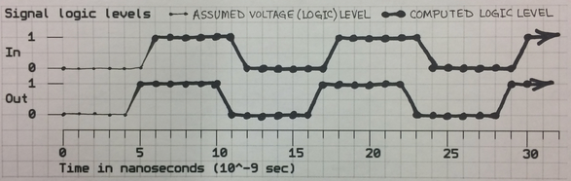
Memory is history, recalled
Gate output is a function of historic input(s)
How can a circuit recall its output?
Use feedback: connect output to input
Look at simplest example, using one NOT gate: Assume that IN=Out=0 at Time = 0, gate propagation delay = 5 ns and wire propagation delay = 1 ns
Plot IN and OUT logic values as functions of time
Notes:
Generate plot together in class.
Use an ink pen if you have it. If using pencil, do not erase. Write name and PUID on paper

Slide 53
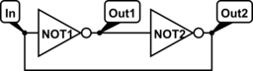
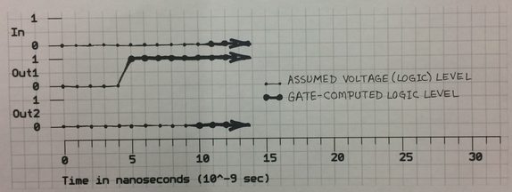
Don’t want an oscillator, so try again
Want memory, not oscillator; try 2 inverters in series
Problem: stable voltage level not under OUR control

Slide 54

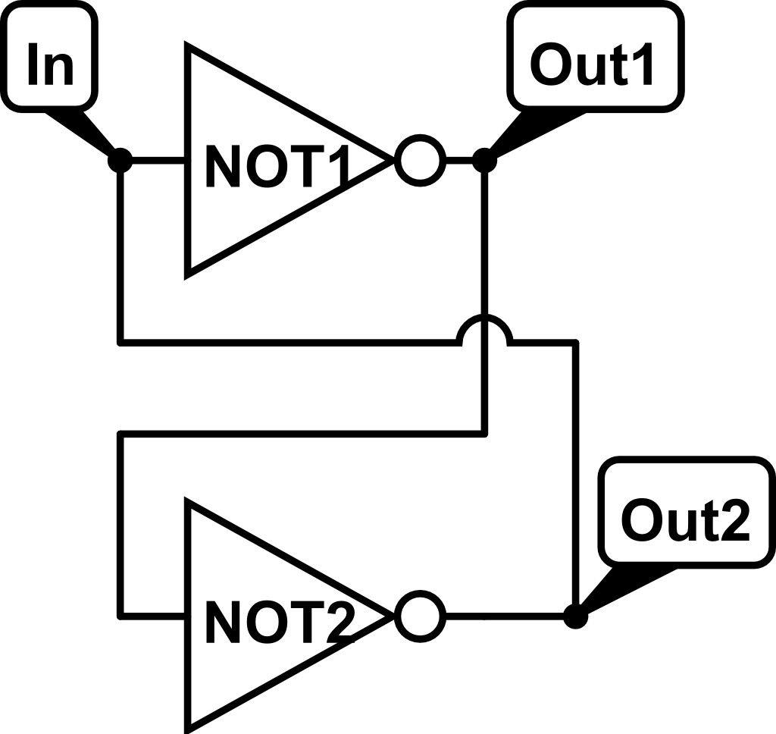
Two ways to diagram a feedback loop
Circular
Twisted

Slide 55
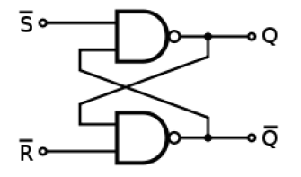
Now, control the stable voltage level
Use NAND as inverter most of the time (gate input external to the feedback loop held to logic 1)
But, when want to control the remembered logic level, use 0 on NAND inputs external to the feedback loop
A zero input will choose a stable voltage level
Two inputs external to the feedback loop: Set, S, makes output Q=1 and Reset, R, makes output Q=0
Control inputs named S’ and R’ because they are active low, or asserted using a low voltage

Slide 56
Set-Reset (S’R’) latch
Text figure 2.14 contains a basic feedback circuit of two NAND gates with each output connected to an input of the other gate
Feedback of a circuit output (history of action) to an input carries that history of the circuit back to the present (a circuit input)
Bringing historic information to the present is the function known as MEMORY
Good experience: Analyze the voltages seen in an S’R’ latch as a function of time

Slide 57
S’R’ latch table deefinitions
S'R latch is a 1-bit memory
Characteristic table
Excitation table
S’ | R’ | Q(t) | Q(t+1)
1 | 1 | X | Q(t)
0 | 1 | X | 1 (set)
1 | 0 | X | 0 (reset)
0 | 0 | X | Not allowed
Q(t) | Q(t+1) | S’ | R’
0 | 0 | 1 | X
0 | 1 | 0 | 1
1 | 0 | 1 | 0
1 | 1 | X | 1

Slide 58
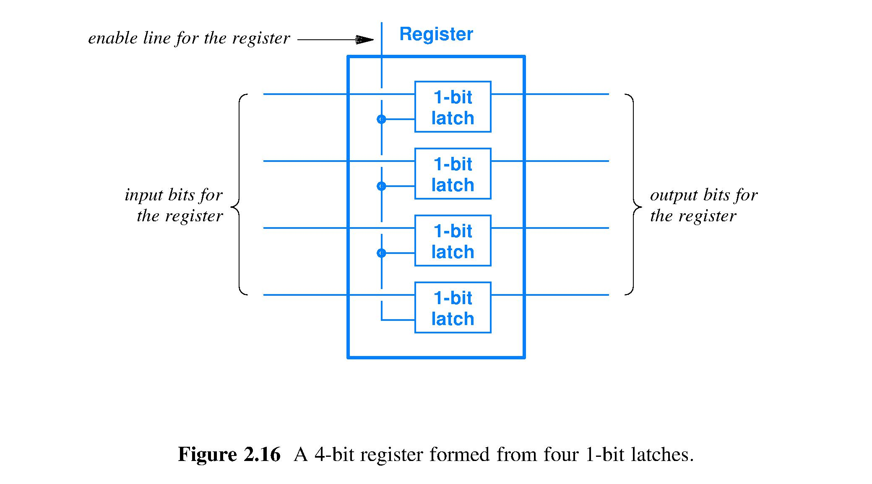
Register – fast storage of a bit string

Slide 59
Summary
Full-adder (1-bit operands) to a 64-bit ripple carry adder: hardware handles larger operands through replication of circuit for narrower operands
Feedback is a fundamental concept
Feedback is essential for a logic circuit to have memory
Fundamental memory circuit is Set-Reset latch
An n-bit register stores an n-bit string
Software often asks a register to store (remember) and later recall the output of an adder:
total recall

Slide 60
How can we represent whatever data using only 0 and 1 symbols?

Slide 61
Week 03 assignments
Read chapter 3
HW 03 will post soon, due Thursday, Feb 01
Lab 04 starts Jan. 30, due following week
Notes:
15 clickers recorded, but without associated student name

Slide 62
Lecture 08 – Why binary?
2018.01.26
Machines take me by surprise with great frequency. – Alan Turing
Notes:
Bring to class: Pentium chip, 7400 data sheet, ABE 5-pole, 25-throw switch

Slide 63
Computing machines
Key insight by Alan Turing: Automate computation by building a machine to carry out a definite method on a finite set of symbols
Definite method is specific enough to correspond to a fixed machine design
Finite set of symbols makes machine input and output manageable
What are the implications of this design?

Slide 64
Why “finite set of symbols”?
The world is analog
temperatures, distances, all parameters in the large world (not quantum-scale world) have possible values best expressed as real numbers
Real numbers are an infinite cardinality set
Increasingly expensive and difficult to build a circuit that can quickly distinguish, say
0.500 volts from 0.499 volts (∆V = 0.001)
0.500000 volts from 0.499999 volts (∆V = 0.000001)
0.500000000 V from 0.499999999 V (∆V = 0.000000001)

Slide 65
Computing with analog values
Analog values are real numbers, so values require an infinite number of digits to represent
Infinite number of digits requires infinite hardware implying cost = $∞ (!!!)
Thus, a machine representation of an analog value must contain some amount of error, ϵ
Example comutation: ideal addition A[1] +A[2] = sum{A[i]} becomes actual A[1]+ϵ[1] + A[2]+ϵ[2] = sum{A[i]} + sum{ϵ[i]}
Error accumulates with each computational step
Notes:
For the game of telephone:

Slide 66
Solve problem of error accumulation
Sum {ϵ[i]} for i=1 to n is unknowable
Sum {ϵ[i]} can grow without limit, or
Sum {ϵ[i]} might mostly cancel out
Cannot know what portion of an analog-computed result is error
For calculations of more than a few steps, obtaining useful results requires a way to represent values without error
Solution: give up expressiveness of analog and compute on a finite set of values that can be represented without error

Slide 67
Simplest symbol set: Unary, or base 1
Unary has one symbol; used for tallying
To represent the number A write the chosen symbol, say, slash /, A times
Let A be //////
Let B be /////////////////
Then A + B is ///////////////////////
Unary number A uses O(A) space ⇒ O(A) hardware to store the number A
What does + mean in unary?
+ means concatenate the symbol strings
So, time to add a pair of numbers is O(A+B), not O(1)

Slide 68
Better: weighted positional, base 10
Number written as series of digits d∊ {0, 1, 2, 3, 4, 5, 6, 7, 8, 9} where value of digit is weighted by its position
Number A written in O(log A) symbols; much less space and hardware than Unary
A + B takes O(log(A+B)) time, much faster
d_{i}x10^{i} + d_{i-1}x10^{i-1} + … + d₁x10¹ + d₀x10⁰
↑ ↑
Most significant digit Least significant digit

Slide 69
Representing symbols
Use voltage because transistor circuits can sense and react to voltage values very quickly
Base 10 requires
10 voltage levels corresponding to {0,1,…,9}
However, typical electrical part has ±5% to ±20% variance from nominal value
Cheaply building many circuits that match well yet use 10 voltage levels is difficult
Look for a weighted positional symbol set needing fewer voltage levels

Slide 70
Simplest weighted positional: base 2
Unlike unary, base 2 (binary) has logarithmic, not linear, time and space complexity
Electrical circuit need only have and distinguish between two different voltage levels: cheapest and fastest choice
Distinguishing symbols requires that the chosen voltages be sufficiently different
Electrical part variation requires acceptance of a range of voltages for each symbol

Slide 71
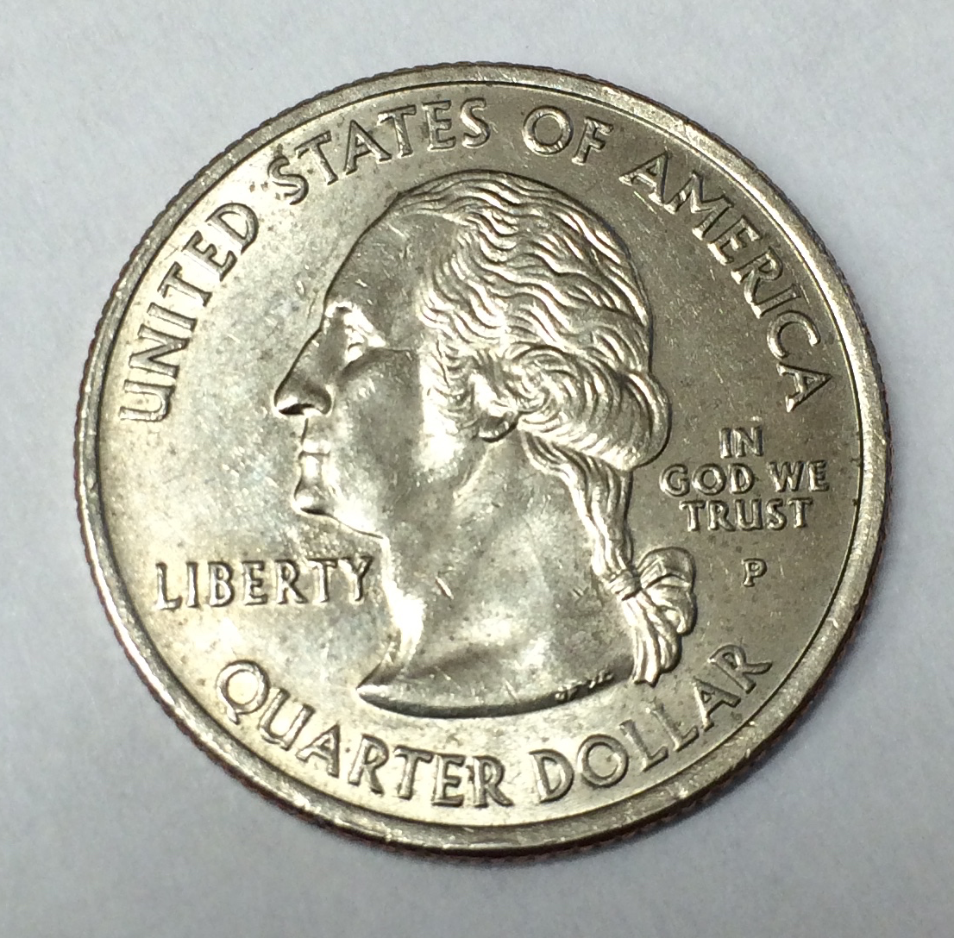
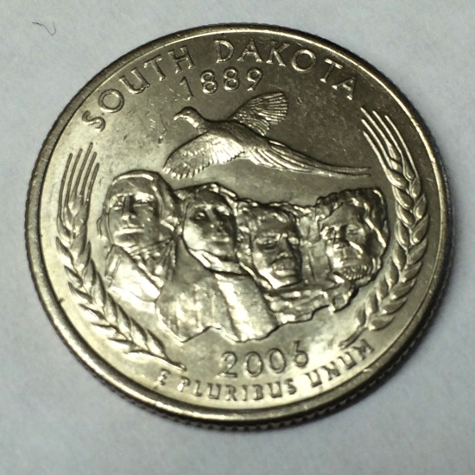


Example two-symbol systems
Heads and tails
Modulo 2 arithmetic:
Statements: Sentences that are either
1 + 1 = 0
True/False ambigram © Scott Kim
Notes:
Ended LE1 here

Slide 72
Summary
Automating computing means using a machine
Using machines to compute depends on finite symbol sets
In an analog world, error accumulates
We can make machines that behave digitally, that use a fixed, finite set of values
Finite symbol sets match manufacturing capability
Clear symbol distinguishability reduces errors, typically to a vanishingly small error rate
Key concepts to achieve the above
Binary (and higher-radix) number systems
Weighted positional notation so that number of symbols is the log of the range of the values

Slide 73
Binary Digit – bit, for short
Direct representation of digital logic values
Mathematical interpretation is 0 and 1
A sequence of bits, called a bit string, is used to represent a complex data item, for example:
character
integer
image
or a text or evs!
The bit string concept is a powerful representational platform

Slide 74
Binary digit strings
A single binary digit (bit) has one of two values
What about a string of bits?
Number of possible patterns of an n-bit string is 2*2*2 … *2 = 2^{n}

Slide 75
General bit strings
There are 2^{k} distinct strings of k bits
Example: all 3-bit strings 000 001 010 011 100 101 110 111
k bits can be carried on k wires
k bits can be stored in k latches
k bits can represent 2^{k} values
k bits can name or point to 2^{k} locations
Notes:
Range is exponential in the number of wires

Slide 76
Powers of 2: the numbers of CS
Learn the powers of 2 from 2⁰ to 2⁴⁹
How?
Memorize decimal equivalents for 10 cases 2⁰, 2¹, 2², 2³, 2⁴, 2⁵, 2⁶, 2⁷, 2⁸, 2⁹ {1, 2, 4, 8, 16, 32, 64, 128, 256, 512}
Memorize names for 2¹⁰, 2²⁰, 2³⁰, 2⁴⁰ {Kilo, Mega, Giga, Tera } know in base 10 {~10³, ~10⁶, ~10⁹, ~10¹² } {thousand, million, billion, trillion}
Combine above and use decomposition to know 2³² bytes = 2^{2+30 bytes} = 2² * 2³⁰ bytes = 4 Gigabytes

Slide 77
What does a binary string mean?
A binary string means, or represents, whatever the circuit designer or the programmer says it does
A bit string has no meaning, until we choose the meaning
Common choices
Numbers, characters, files, status of peripheral devices
… many, many more possibilities

Slide 78
Example: a UNIX file
UNIX views a file as a sequence of bytes
Byte = 8-bit binary string
For most computers, byte is the smallest unit of information directly accessible from storage
Let’s “look at” the bytes of a mystery file
Notes:
Showed a file of the Purdue logo at this point in the lecture, as it is interpreted by various “viewing” programs: more, od, xxd, and Apple Preview

Slide 79
Show a file of the Purdue logo as it is interpreted by various “viewing” programs: more, od, xxd, and Preview.app (Apple)

